Slide 1
Generator
Characteristics

Slide 2
Generator Characteristics
Characteristics of D.C. Generators
Separately-excited Generator
No-load Curve for Self-excited Generator
How to find Critical Resistance R_{c}?
How to draw O.C.C. at Different Speeds ?
Critical Speed
Voltage Build up of a Shunt Generator
Conditions for Build-up of a Shunt Generator
Other factors Affecting Voltage Building of a D.C. Generator
External Characteristic
Voltage Regulation
Internal or Total Characteristic
Series Generator
Compound-wound Generator
How to calculate Required Series Turns?
Uses of D.C. Generators

Slide 3
Characteristics of D.C. Generators
Following are the three most important characteristics or curves of a d.c. generator :
No-load saturation Characteristic (E₀/I_{f})
Internal or Total Characteristic (E/I_{a})
External Characteristic (V/I)

Slide 4
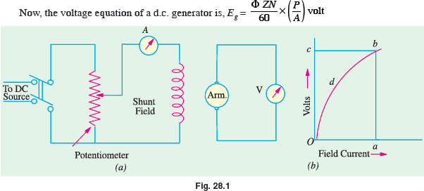
Separately – Excited Generator
(a) (i) No-load Saturation Characteristic (E₀/I_{f})
The arrangement for obtaining the necessary data to plot this curve is shown in Fig. 28.1. The exciting or field current I_{f} is obtained from an external independent d.c. source. It can be varied from zero upwards by a potentiometer and its value read by an ammeter A connected in the field circuit as shown.
Contd….

Slide 5
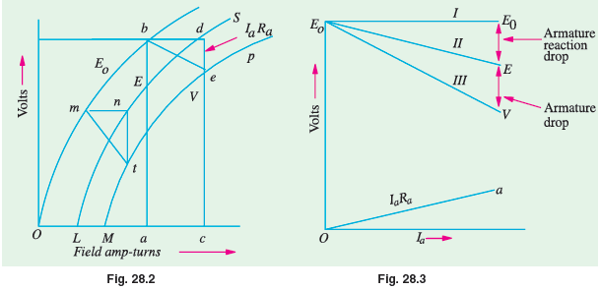
Separately – Excited Generator
(ii) Load Saturation Curve (V/I_{f})
The curve showing relation between the terminal voltage V and field current If when the generator is loaded, is known as Load Saturation Curve. The curve can be deduced from the no-load saturation curve provided the values of armature reaction and armature resistance are known.
Contd….

Slide 6
Separately – Excited Generator
(b) Internal and External Characteristics
Let us consider a separately-excited generator giving its rated no-load voltage of E₀ for a certain constant field current. If there were no armature reaction and armature voltage drop, then this voltage would have remained constant as shown in Fig. 28.3. by the dotted horizontal line I. But when the generator is loaded, the voltage falls due to these two causes, thereby giving slightly dropping characteristics.
If we subtract from E₀ the values of voltage drops due to armature reaction for different loads, then we get the value of E–the e.m.f. actually induced in the armature under load conditions. Curve II is plotted in this way and is known as the internal characteristic.

Slide 7
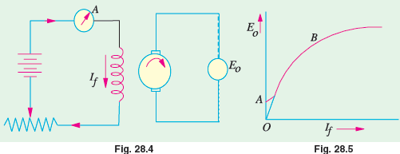
No – Load Curve for Self – Excited Generator
The O.C.C. or no-load saturated curves for self-excited generators whether shunt or series connected, are obtained in a similar way.
The field winding of the generator (whether shunt or series wound) is disconnected from the machine and connected to an external source of direct current as shown in Fig. 28.4.
On plotting the relation between If and E0, a curve of this form shown in Fig. 28.5 is obtained.
Contd….

Slide 8
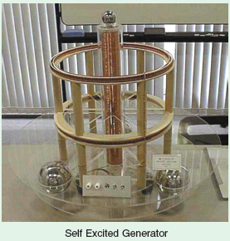
No – Load Curve for Self – Excited Generator
Critical Resistance for Shunt Generator
Now, connect the field windings back to the armature and run the machine as a shunt generator. Due to residual magnetism in the poles, some e.m.f. and hence current, would be generated. This current while passing through the field coils will strengthen the magnetism of the poles (provided field coils are properly connected as regards polarity). This will increase the pole flux which will further increase the generated e.m.f.

Slide 9
How to Find Critical Resistance R_{c}?
First, O.C.C. is plotted from the given data. Then, tangent is drawn to its initial portion.
The slope of this curve gives the critical resistance for the speed at which the data was obtained.

Slide 10
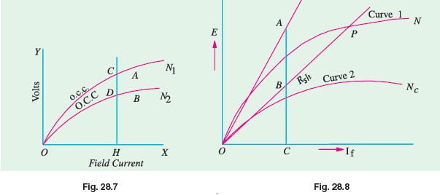
How to Draw O.C.C. at Different Speeds?
Suppose we are given the data for O.C.C. of a generator run at a fixed speed, say, N₁. It will be shown that O.C.C. at any other constant speed N₂ can be deduced from the O.C.C. for N₁. In Fig. 28.7 the O.C.C. for speed N₁ is shown.
Contd….

Slide 11

Critical Speed N_{c}
Critical speed of a shunt generator is that speed for which the given shunt field resistance represents critical resistance. In Fig. 28.8, curve 2 corresponds to critical speed because R_{sh} line is tangential to it. Obviously

Slide 12
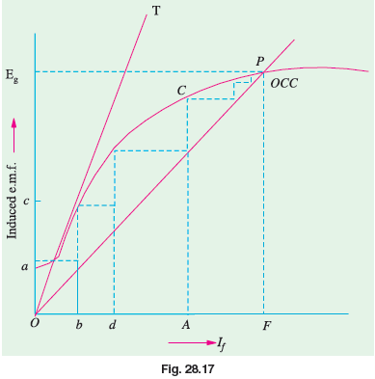
Voltage Build up of a Shunt Generator
Before loading a shunt generator, it is allowed to build up its voltage. Usually, there is always present some residual magnetism in the poles, hence a small e.m.f. is produced initially.
When flux is increased,
generated e.m.f. is increased
which further increases the
flux and so on. As shown in Fig.
28.17, Oa is the induced e.m.f.
due to residual magnetism
which appears across the field
circuit and causes a field current
Ob to flow.

Slide 13
Conditions for Build – up of a Shunt Generator
We may summarize the conditions necessary for the build-up of a (self-excited) shunt generator as follows:
There must be some residual magnetism in the generator poles.
For the given direction of rotation, the shunt field coils should be correctly connected to the armature i.e. they should be so connected that the induced current reinforces the e.m.f. produced initially due to residual magnetism.
If excited on open circuit, its shunt field resistance should be less than the critical resistance (which can be found from its O.C.C.)
If excited on load, then its shunt field resistance should be more than a certain minimum value of resistance which is given by internal characteristic (Art 28.11).
Contd….

Slide 14
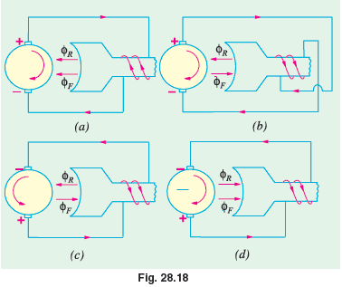
Conditions for Build – up of a Shunt Generator

Slide 15
Other Factors Affecting Voltage Building of a DC Generator
In addition to the factors mentioned above, there are some other factors which affect the voltage building of a self-excited d.c. generator. These factors are:
reversed shunt field connection
reversed rotation and
reversed residual magnetism.
These adverse effects would be explained with the help of Fig. 28.18 and the right-hand rule for finding the direction of the coil flux.

Slide 16
External Characteristic
Armature resistance drop :
As the load current increases, more and more voltage is consumed in the ohmic resistance of the armature circuit. Hence, the terminal voltage V = E − I_{a} R_{a} is decreased where E is the induced e.m.f. in the armature under load condition.
Armature reaction drop
Due to the demagnetising effect of armature reaction, pole flux is weakened and so the induced e.m.f. in the armature is decreased.
The drop in terminal voltage V due to (i) and (ii) results in a decreased field current I_{f} which further reduces the induced e.m.f.

Slide 17
Voltage Regulation
The voltage regulation of a d.c. generator is the change in voltage when the load is reduced from rated value to zero, expressed as percentage of the rated load voltage.
If no-load voltage of a certain generator is 240 V and rated-load voltage is 220 V,
then, regn. = (240 − 220)/220 = 0.091 or 9.1 %

Slide 18
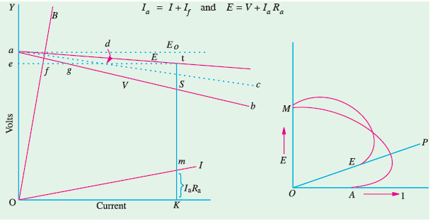
Internal or Total Characteristic
As defined before, internal characteristic gives the relation between E and Ia. Now in a shunt generator Hence, E/Ia curve can be obtained from V/I curve as shown in Fig.

Slide 19
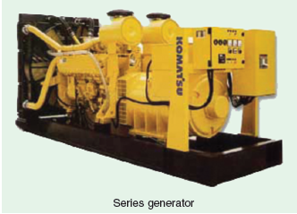
Series Generator
In this generator, because field windings are in series with the armature [Fig. 28.23 (a)], they carry full armature current I_{a}. As I_{a} is increased, flux and hence generated e.m.f. is also increased as shown by the curve. Curve Oa is the O.C.C. The extra exciting current necessary to neutralize the weakening effect of armature reaction at full load is given by the horizontal distance ab. Hence, point b is on the internal characteristic. If the ordinate bc = gh = armature voltage drop, then point c lies on the external characteristic [Fig. 28.23 (b)].
Contd….

Slide 20
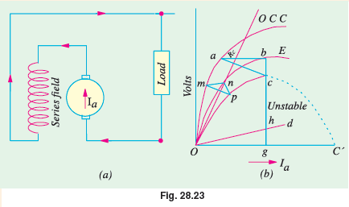
Series Generator

Slide 21
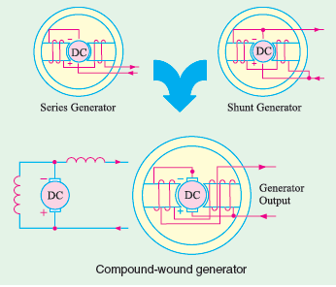
Compound – Wound Generator
A shunt generator is unsuitable where constancy of terminal voltage is essential, because its terminal voltage decreases as the load on it increases.
This decrease in V is particularly objectionable for lighting circuit where even slight change in the voltage makes an appreciable change in the candle power of the incandescent lamps.

Slide 22
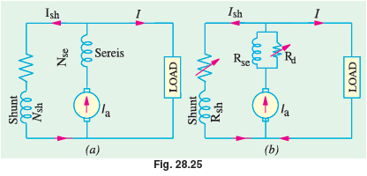
How to Calculate Required Series Turns?
Consider a 110-V, 250-ampere generator. Suppose it gives its rated no-load voltage with a field current of 5.8 A. If, now, the series windings are disconnected and the shunt field rheostat is left unchanged then the machine will act as shunt generator, hence its voltage will fall with increase in load current.

Slide 23
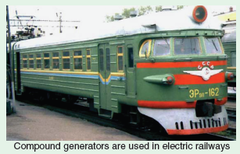
Uses of D.C. Generators
Shunt Generators with field regulators are used for ordinary lighting and power supply purposes.
Series Generators are not used for power supply because of their rising characteristics.
Compound Generators The cumulatively-compound generator is the most widely used d.c. generator because its external characteristic can be adjusted for compensating the voltage drop in the line resistance.

